Slide 1

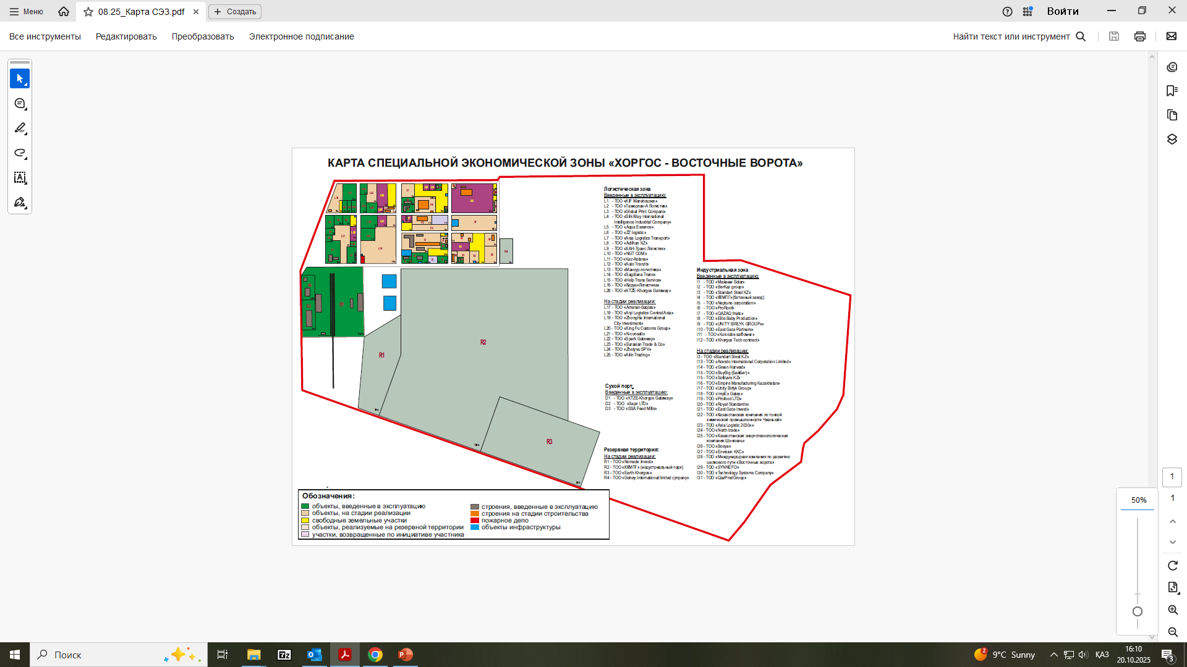



SEZ KHORGOS-EAST GATE
Operating period: 2011 – 2036years
Purpose of establishment: development of cross-border trade and economic cooperation and the establishment of an effective transport-logistics and industrial center that meets the interests of trade-export activities and realizes the transit potential of the Republic of Kazakhstan, as well as contributing to the development of economic and cultural exchange with neighboring countries
Total area – 5431.5 ha
Free area – 3867.9 ha
Occupied territory – 669.5 ha
Infrastructure – 54.1 ha
Infrastructure completion – 100 %
Industry:
LOGISTICS
Production of products from chemical, metallurgical and other industries
Shareholder:
Akimat of the region Zhetysu - 100%
MANAGEMENT:
JSC "UK SEZ 'Khorgos – East Gate'""
Staff: 83 people
infrastructure
26.8
36.9 billion KZT
Volume of investments
7
62.6billion KZT
Volume
7.3
89.7 Permanent
Volume of tax deductions
11.8Permanent
jobs
168
694 units
Return on 1 KZT invested in infrastructure
1.7 KZT
KZT KZT
2.8
private investments
1

Slide 2
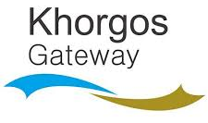
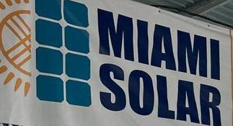
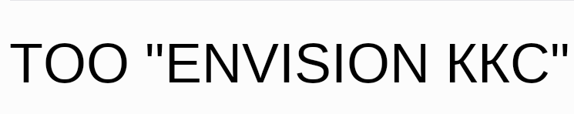





PRIORITY TYPES OF ACTIVITIES
SUCCESSFUL PROJECTS
production of chemical industry products;
warehousing and auxiliary transport activities;
production of food products;
production of leather and related products;
production of textile products;
production of other non-metallic mineral products;
production of chemical industry products;
production of finished metal products, except machinery and equipment;
production of machinery and equipment not included in other categories;
construction in accordance with project and estimate documentation of buildings for organizing exhibitions, a museum, warehouses, and administrative buildings;
construction and commissioning of facilities intended directly for priority activities, within the design and estimate documentation;
marine aquaculture;
freshwater aquaculture;
production of paper products for household and sanitary-hygienic purposes;
production of electronic components;
production of cast iron, steel, and ferroalloys;
construction and commissioning of hotels with restaurants in accordance with project and estimate documentation;
repair and maintenance of aircraft and spacecraft;
wholesale trade in aviation gasoline and kerosene
LLP "KTZE-Khorgos Gateway"
multimodal container terminal
Cost – 36.3 billionKZT
Jobs - 388
LLP "Miami Solar
export of solar panels to the USA
Cost – 1.2 billionKZT
Jobs - 11
LLP "Envision KKS"wind turbines and energy storage systems
Cost – 20 billion KZT
Jobs - 40
LLP "Empire Manufacturing Kazakhstan" (MacCoffee) production of 3-in-1 beverages
Cost – 6.7 billionKZT
Jobs - 300
TARIFFS
Water Supply
Electricity Supply
Sewage
Heat Supply
149.17m³
34.91 kW
68.25m³
31818.87 Gcal

