Slide 1

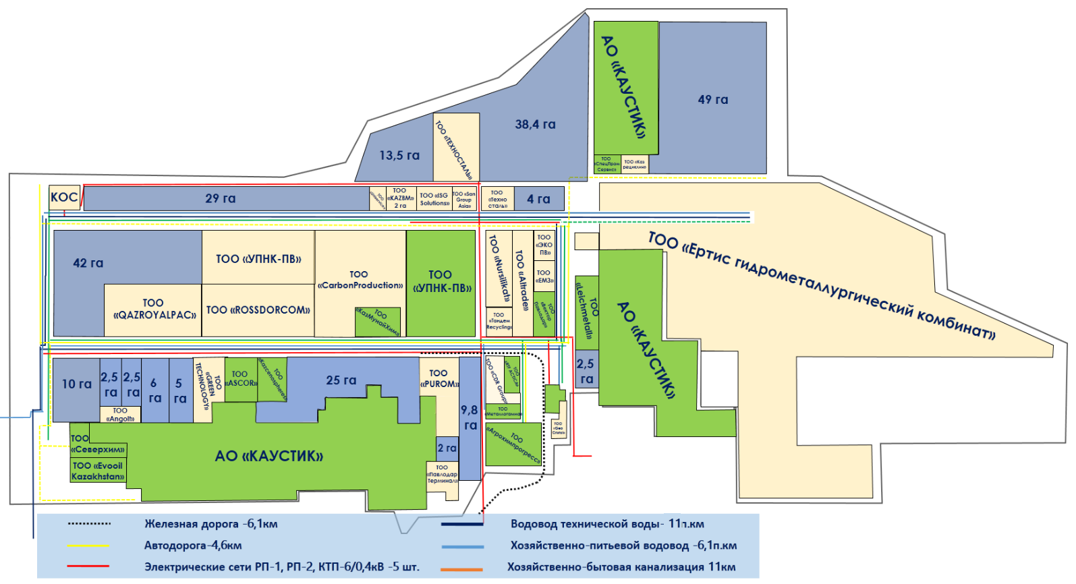



SEZ PAVLODAR
Operational period: 2011 – 2036 years
Purpose of establishment: development of the chemical and petrochemical industries based on modern eco-friendly technologies, deep processing of raw materials, and production of competitive export products with high added value, attracting investments and creating jobs
Total area – 1,280 ha
Available area – 371.3 ha
Occupied area – 582.4 ha
Infrastructure – 150 ha
Infrastructure completion – 65.8%
Sector:
MANUFACTURING INDUSTRY
Production of products from chemical, metallurgical, and other industries
Shareholder:
Department of Industrial-Innovative Development of the Pavlodar Region Akimat – 100 %
MANAGEMENT:
JSC "MC SEZ "Pavlodar"
Staff: 25 people
13.2 KZT
2.7 KZT
private investments
Invested in
infrastructure
13.7 billion KZT
Volume of invested
investments
184.6 billion KZT
Volume
production
407.3 billion tenge
Volume of tax deductions
37.8 billion tenge
Permanent
jobs
1,705 units
Return on 1 KZT invested in infrastructure
tax revenues
1

Slide 2

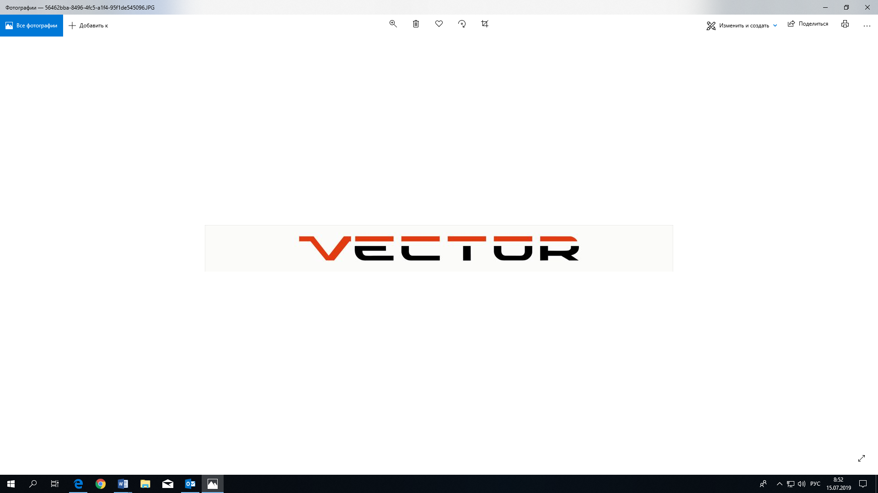


INVESTMENT OPPORTUNITIES
SUCCESSFUL PROJECTS
PRIORITY ACTIVITIES
Production of coke and petroleum products
Production of chemical industry products
Production of rubber and plastic products
Production of other non-metallic mineral products
Metallurgical industry
Manufacture of fabricated metal products, except machinery and equipment
Construction and commissioning of facilities intended directly for the implementation of priority activities, within the design and estimate documentation
Construction and commissioning of a multidisciplinary hospital
LLP "UPNK-PV""
Calcined petroleum coke
Cost – 22.9 billionKZT
Jobs - 399
LLP "Vector Pavlodar"
Automobile wheels
Cost – 6.7 billionKZT
Jobs - 121
JSC "Kaustik"
Caustic soda and chlorine
Cost – 16.6 billionKZT
Jobs - 497
LLP "EvooilKazakhstan"
Motor oils and lubricants
Cost – 5.5 billionKZT
Jobs - 32
TARIFFS
Service | SEZ tariff | City tariff (excluding VAT)
electricity | 32.58 KZT./kWh | 32.58 KZT./kWh
technical water | 53.1 KZT./m3 | 31.17 KZT./m3 – Vodokanal Severny 147.7 KZT./m3 - Pavlodar-Vodokanal 127.17 KZT./m3 - LLP "PNHZ"
domestic drinking water | 441.33 KZT./m3 | 353.33 KZT./m3 - Pavlodar-Vodokanal 488.66 KZT./m3 – LLP "PNHZ"

